Slide 1
ᏣᎳᎩ ᎦᏬᏂᎯᏍᏗ 132
ᎤᎾᏙᏓᏉᏅᎢ, ᏚᏃᎸᏔᏂ 27, 2014

Slide 2
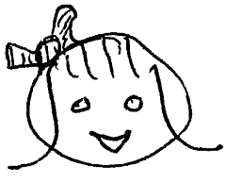
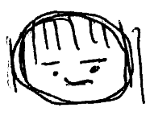
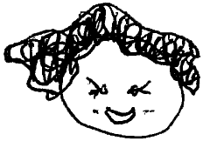
Short Dialogues
Siyo! Hiwoninhatsu Tsalagi?
Siyo. Gayohli tsiwoniha Tsalagi.
Elisi tsoginenvsvi osdiwonisgoi.
NB: Agi-/Agw- Set and Tsi-/G- Set

Slide 3
Tsi-/G- Pronouns
-woniha ‘is speaking Present’
Tsi- ~ Ga- Consonant Stem Pattern
Tsi-woniha. |  | Hi-woniha. | Ga-woniha.
Osdi-woniha. | Ini-woniha. | Sdi-woniha.
Otsi-woniha. | Idi-woniha. | Itsi-woniha. | Ani-woniha.

Slide 4
Interview Neighbor
A: Hiwonihatsu Tsalagi?
B: Vv. Tsalagi tsiwoniha.
B: Hadi. Gesdi yitsiwoniha Tsalagi.
Answer to class:
Hia oginalii, Uneg Tsisdu. Tsalagi gawoniha.

Slide 5
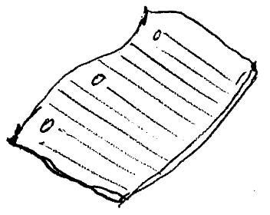
Short Dialogues
Do iyusdi hia?
Hia gohweli.
Do hadvneha?
Gohweli tsigoliyea.

Slide 6
Tsi-/G- Pronouns
-goliyea ‘is reading Present’
Tsi- ~ A- Consonant Stem Pattern
Tsi-goliyea. |  | Hi-goliyea. | A-goliyea.
Osdi-goliyea. | Ini-goliyea. | Sdi-goliyea.
Otsi-goliyea. | Idi-goliyea. | Itsi-goliyea. | Ani-goliyea.

Slide 7
Interview Neighbor
A: Do iyusdi higoliyea?
B: Gohweli tsigoliyea.
B: Gesdi yitsigoliyea.
Answer to class:
Hia oginalii. Tsalagi gawonihisdi agoliyea.

Slide 8
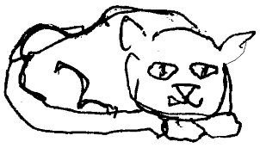
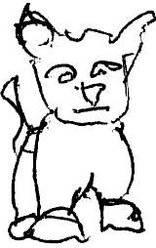
Short Dialogues
Wesa dagikaha.
Analsgisgoitsu wesa?

Slide 9
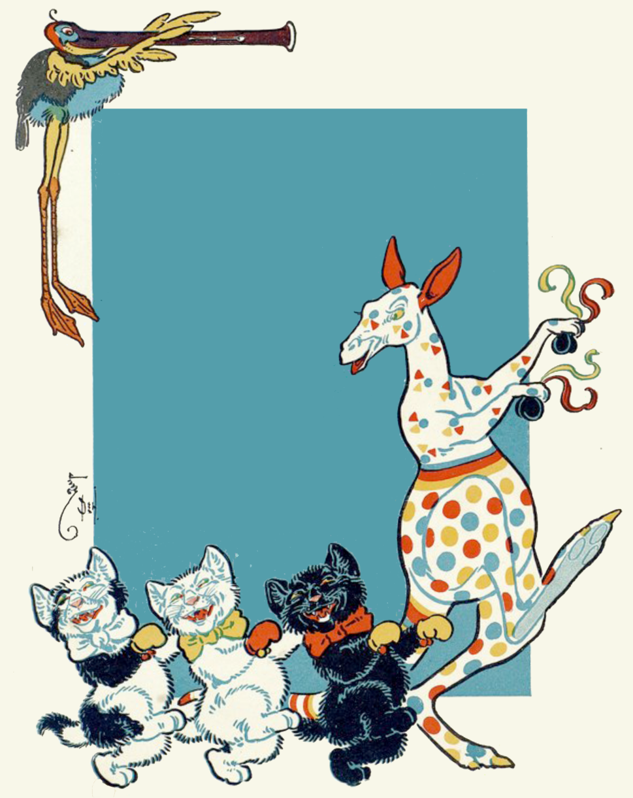
Short Dialogues
Vv. Analsgisgoi
wesa dagikahvi.
NB: -alsgisg- Imperfective

Slide 10
Tsi-/G- Pronouns
-alsgia ‘is dancing Present’
G- ~ A- a-Vowel Stem Pattern
G-alsgia. |  | H-alsgia. | Alsgia.
Osd-alsgia. | In-alsgia. | Sd-alsgia.
Ots-alsgia. | Id-alsgia. | Its-alsgia. | An-alsgia.

Slide 11
Interview Neighbor
A: Halsgiasg?
A: Nogwutsu halsgia?
B: Vv. Galsgia.
B: Hadi. Gesdi yigalsgia nogwu.
Report to class: Gesdi yalsgia nogwu oginalii.

Slide 12
Short Dialogues
Do hadvneha?
Gohweli tsigoliyea.
Ihina? Do hadvneha?
Kahwi gaditasga.

Slide 13
Tsi-/G- Pronouns
-advneha ‘is doing Present’
G- ~ A- a-Vowel Stem Pattern
G-advneha. |  | H-advneha. | Advneha.
Osd-advneha. | In-advneha. | Sd-advneha.
Ots-advneha. | Id-advneha. | Its-advneha. | An-advneha.

Slide 14
Tsi-/G- Pronouns
-aditasga ‘is drinking Present’
G- ~ A- a-Vowel Stem Pattern
G-aditasga. |  | H-aditasga. | Aditasga.
Osd-aditasga. | In-aditasga. | Sd-aditasga.
Ots-aditasga. | Id-aditasga. | Its-aditasga. | An-aditasga.

Slide 15
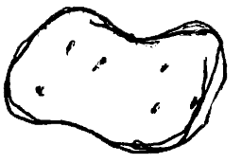
Short Dialogues
Do hadvneha?
Gohweli gowelia.
Ihina? Do hadvneha?
Nuna degu'iloa.

Slide 16
Tsi-/G- Pronouns
-ohwelia ‘is writing Present’
G- ~ G- Vowel Stem Pattern
G-owelia. |  | H-ohwelia. | G-ohwelia.
Osd-ohwelia. | In-ohwelia. | Sd-ohwelia.
Ots-ohwelia. | Id-ohwelia. | Its-ohwelia. | An-ohwelia.

Slide 17
Tsi-/G- Pronouns
-uhiloa ‘is washing it Present’
G- ~ G- Vowel Stem Pattern
G-u'iloa. |  | H-uhiloa. | G-uhiloa.
Osd-uhiloa. | In-uhiloa. | Sd-uhiloa.
Ots-uhiloa. | Id-uhiloa. | Its-uhiloa. | An-uhiloa.

Slide 18
Tsi-/G- Pronouns
de- -uhiloa ‘is washing them Present’
G- ~ G- Vowel Stem Pattern
With de- Event Plural
De-g-u'iloa. |  | De-h-uhiloa. | De-g-uhiloa.
D-osd-uhiloa. | Dé-n-uhiloa. | De-sd-uhiloa.
D-ots-uhiloa. | Dé-d-uhiloa. | Dé-ts-uhiloa. | D-an-uhiloa.

Slide 19
Interview Neighbor
A: Do hadvneha?
A: Tsalagi tsiwoniha. Gohweli tsigoliyea. Galsgia. Gaditasga. Gowelia. Nuna degu'iloa.
Report to class: Oginalii Tsalagi gawoniha, agoliyea, alsgia, aditasga, gohwelia, nole nuna deguhiloa.

