Slide 1
ᏣᎳᎩ ᎦᏬᏂᎯᏍᏗ 132
ᎤᎾᏙᏓᏉᏅᎢ, ᎠᏅᏱ 3, 2014

Slide 2
Days of the Week
'Gwee! It's Saturday!'
Unadodagwidena
ᎤᎾᏙᏓᏈᏕᎾ
Alt: dodagwiden
Do iyusdi hadvnehoi Unadodagwidena?
What do you do on Saturday?

Slide 3
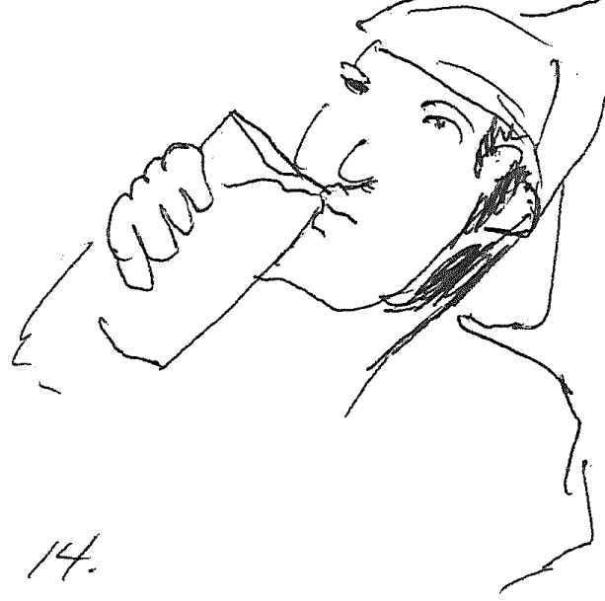
ᎤᎾᏙᏓᏈᏕᎾ
Nigohilv Unadodagwidena
unvdi gaditasgoi.
Always on Saturday
I drink milk.

Slide 4
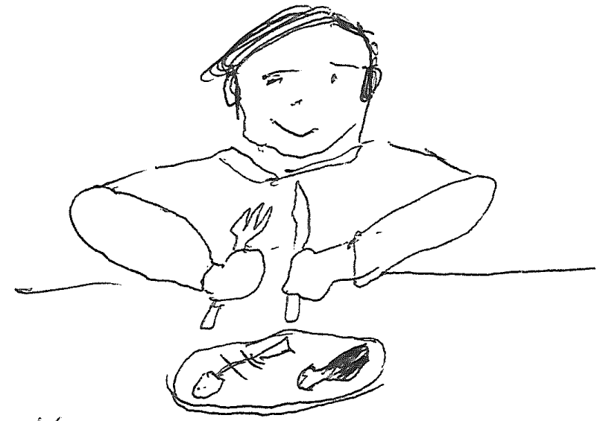
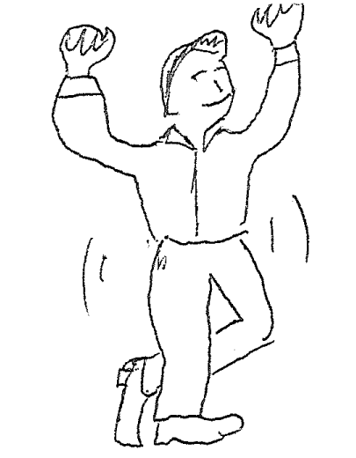
Nihi nigada nogwu.
Do iyusdi itsadvnehoi unadodagwidena?
Take a few minutes and ask and answer.
Galsgisgoi.
Galsdayvhvsgoi.
Gaditasgoi

Slide 5
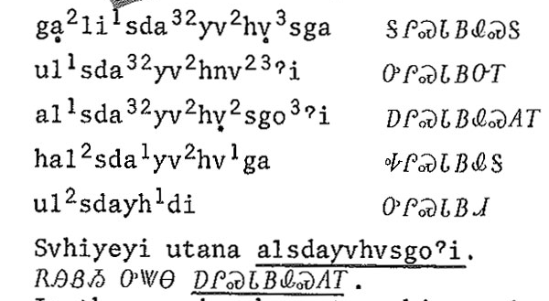
Alsdayvhvsga.

Slide 6
Tsi-/G- Set Forms
Present:
Alsdayvhvsga. She is eating a meal.
Galsdayvhvsga. I am eating a meal.
Imperfective Habitual:
Alsdayvhvsgoi. He eats a meal.
Immediate Command:
Halsdayvhvga! Eat a meal!

Slide 7
Days of the Week
'It's Sgvnday!'
Unadodagwasgv'i
ᎤᎾᏙᏓᏆᏍᎬᎢ
Alternative: dodagwasgv
Do iyusdi hadvnehoi Unadodagwasgvi?

Slide 8
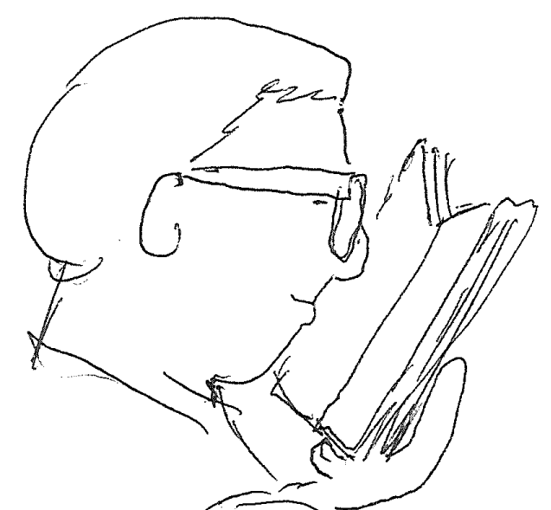
ᎤᎾᏙᏓᏆᏍᎬᎢ
Nigohilv Unadodagwasgvi
Tsalagi tsigoliyesgoi.
Always on Sunday
I read Cherokee.

Slide 9
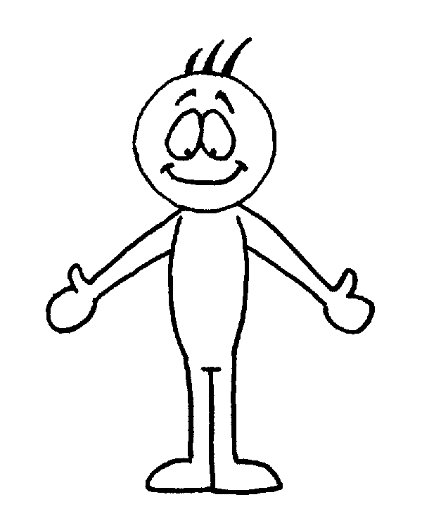
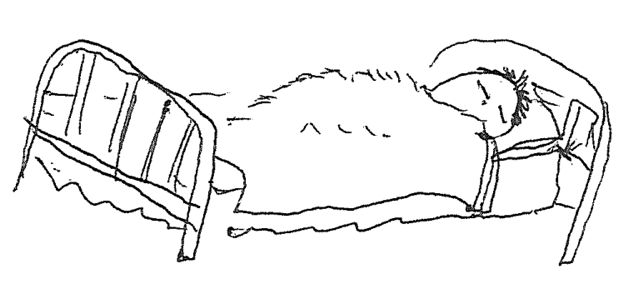
Nihi nigada nogwu.
Do iyusdi itsadvnehoi Unadodagwasgvi?
Take a minute and ask each other about Sunday habitual activities.
Tsigoliyesgoi.
Tsidogoi.
Tsihlihoi.

Slide 10
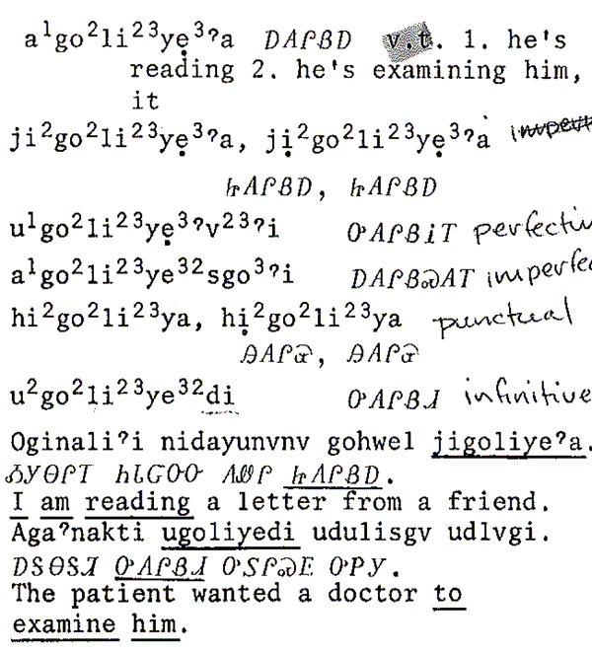
Agoliyea.

Slide 11
Tsi-/G- Set Forms
Present:
Agoliyea. He is reading.
Tsigoliyea. I am reading.
Imperfective Habitual:
Agoliyesgoi. He reads.
Immediate Command:
Higoliya! Read!

Slide 12
Days of the Week
'Whoa, it's Monday.'
Unadodagwonv'i
ᎤᎾᏙᏓᏉᏅᎢ
Alt: dodagwonv
Do iyusdi hadvnehoi Unadodagwonvi?

Slide 13
ᎤᎾᏙᏓᏉᏅᎢ
Nigohilv Unadodagwonvi
gadawosgoi.
Always on Monday
I swim.

Slide 14
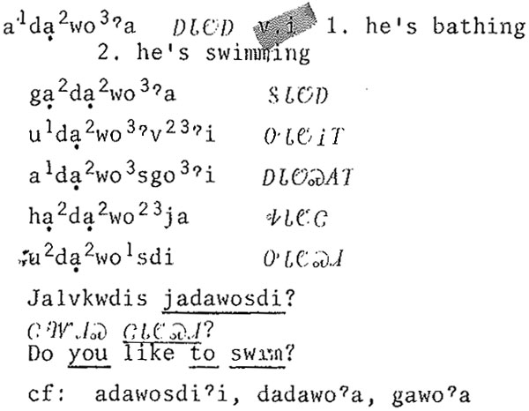
Adawoa.

Slide 15
Tsi-/G- Set Forms
Present:
Adawoa. She is swimming.
Gadawoa. I am swimming.
Imperfective Habitual:
Adawosgoi. She swims.
Immediate Command:
Hadawotsa! Swim!

Slide 16
Days of the Week
Brainstorm sound mnemonic.
Tsungilosdi
ᏧᎾᎩᎶᏍᏗ
wash day; Archaic: hisgine iga 'fifth day'
Do iyusdi hadvnehoi Tsungilosdi?

Slide 17
ᏧᎾᎩᎶᏍᏗ Laundry Day

Slide 18
Nihi nigada nogwu.

Slide 19
Days of the Week
Taline Iga ᏔᎵᏁ ᎢᎦ second day Tuesday
Tsoine Iga ᏦᎢᏁ ᎢᎦ third day Wednesday
Nvgine Iga ᏅᎩᏁ ᎢᎦ fourth day Thursday
Do iyusdi hadvnehoi Taline Iga?

Slide 20
Nihi nigada nogwu.

