Slide 1
ᏣᎳᎩ ᎦᏬᏂᎯᏍᏗ 132
ᎤᎾᏙᏓᏉᏅᎢ, ᎠᏅᏱ 17, 2014

Slide 2
Activities Bingo
Create Bingo sheets. Fold paper four times to create 4x4 grid.
Randomly number grid from 1 to 16.
Quickly sketch one activity as each number is called.

Slide 3
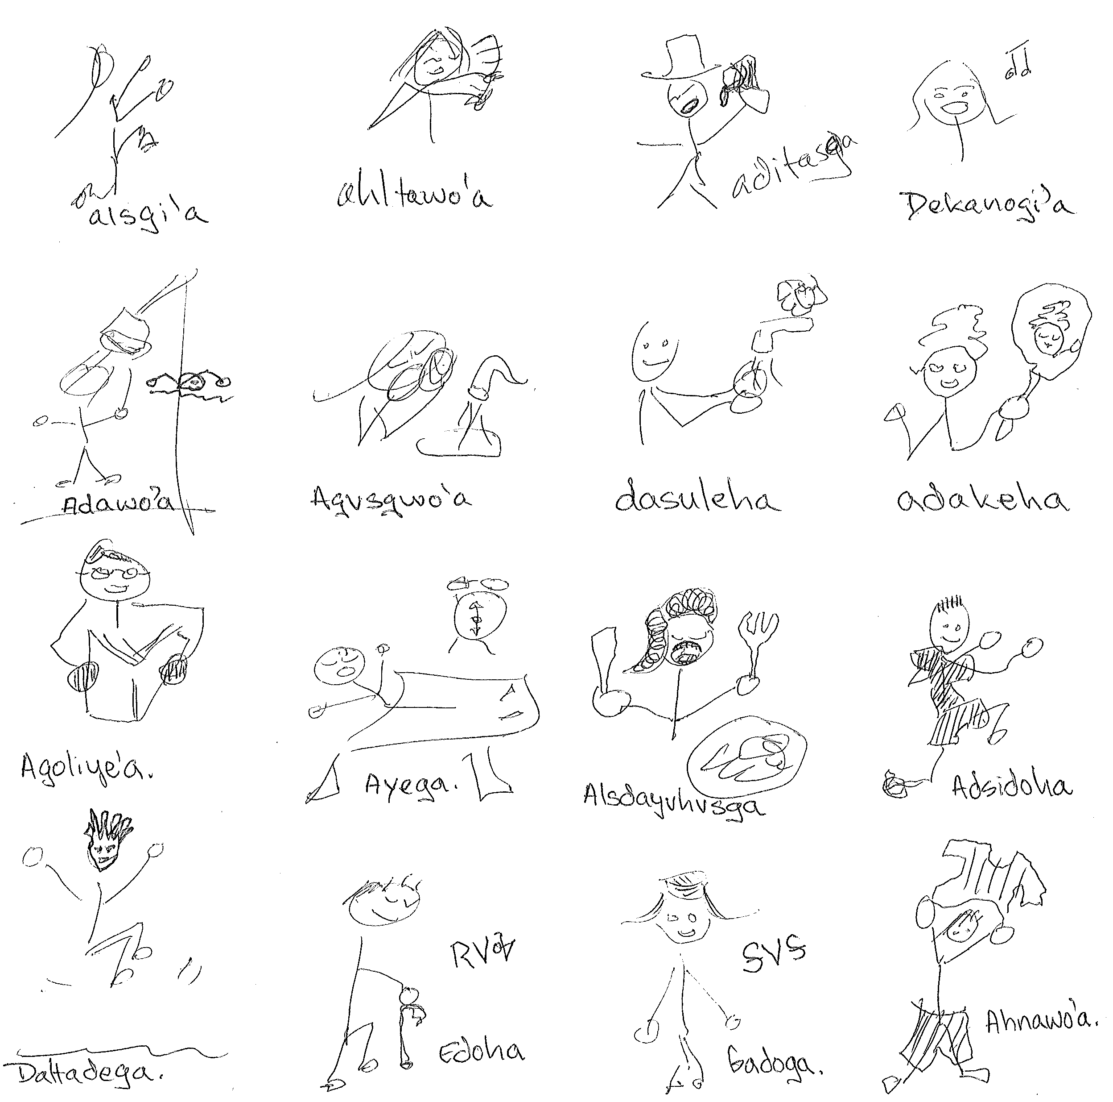
Finished Grids

Slide 4
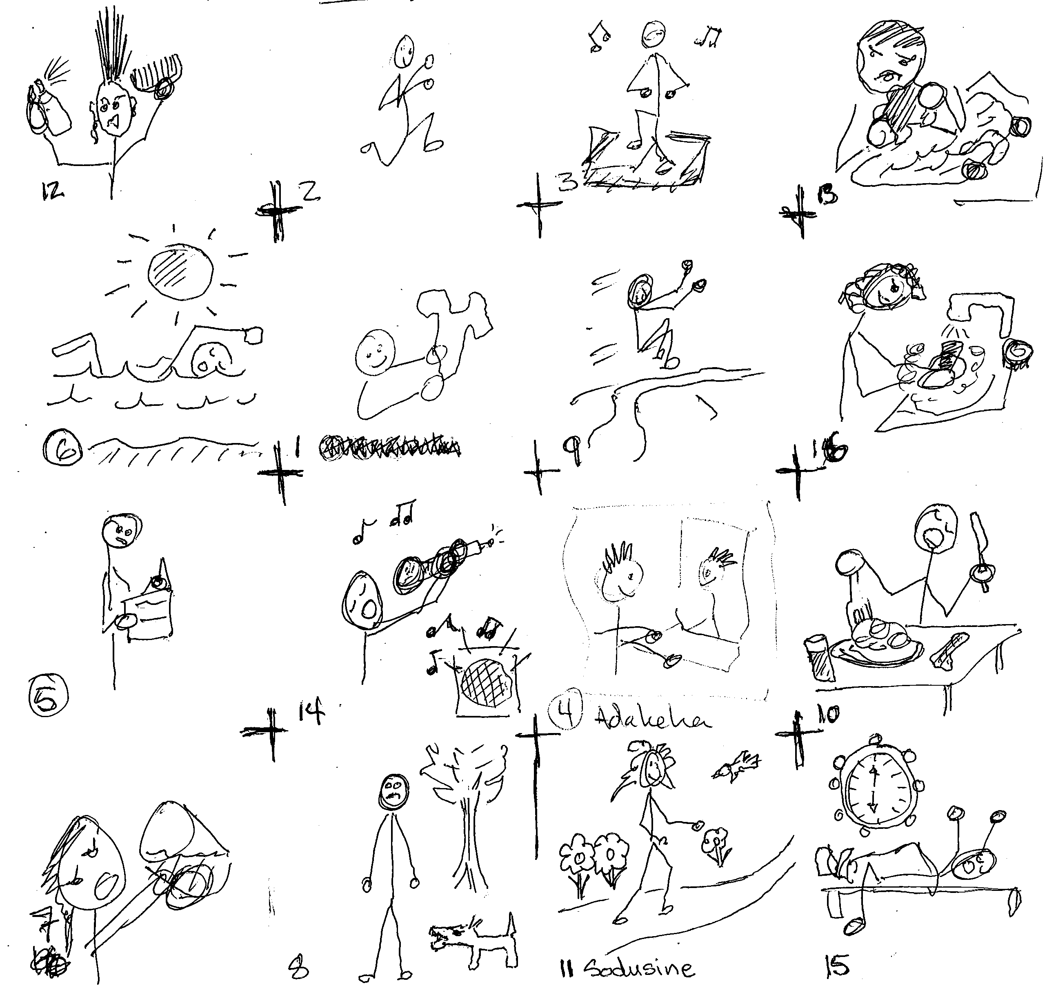
Finished Grids

Slide 5
Imperfective Stem
What is the Stem? The Stem is everything except the Pronoun and the Final Ending.
Cherokee Language shows a system of 5 Stems:
Present – Current Time Reference
Immediate – Just Now Time Reference
Imperfective – Open Temporal Extent
Perfective – Closed Temporal Extent
Infinitive – No Time Reference

Slide 6
Imperfective Stem
What is the Stem? The Stem is everything except the Pronoun and the Final Ending.
Why the Imperfective Stem? It’s useful!
The Imperfective combines with Final Forms to create a range of sentences (unlike the Present, the Immediate, and the Infinitive).
g-alsgisg-oi I dance.
g-alsgisg-vi I was dancing.
g-alsgisg-esdi I will be dancing.
g-alsgisg-i I Dancer

Slide 7
Imperfective Habitual
We go through the Activities with the Imperfective Habitual Verb Word Sentences.
Pronoun + Imperfective Stem + oi Habitual Final
Do advnehoi nigohilv? What does she always do?
Alsgisgoi. Nigohilv alsgisgoi.
She dances. She always dances.

Slide 8
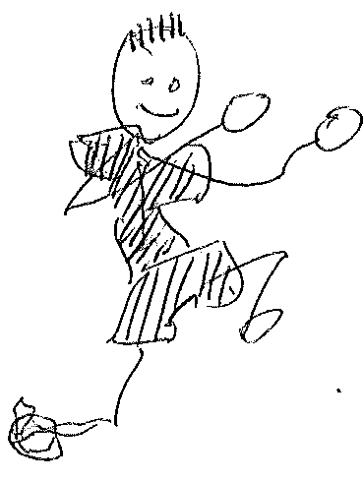
Do advnehoi nigohilv?
Alsgisgoi.
NB: One other form is required to identify the Stem. Galsgisgoi. I dance.
G- First Person Singular
A- Third Person Singular
g- ~ a- a-Stem Pronoun Pattern
-alsgisg- Imperfective Stem

Slide 9
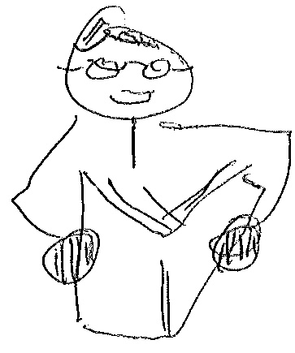
Do advnehoi nigohilv?
Agoliyesgoi.
Tsigoliyesgoi.
a- 3rd Singular
tsi- 1st Singular
tsi- ~ a- Consonant Stem Pronoun Pattern
-goliyesg- Imperfective Stem

Slide 10
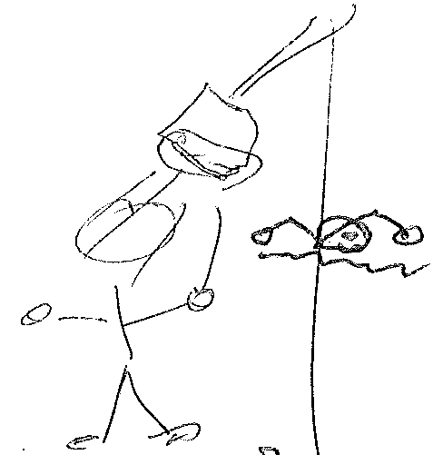
Do advnehoi nigohilv?
Adawosgoi.
Gadawosgoi.
a- 3rd Singular
g- 1st Singular
g- ~ a- a-Stem Pronoun Pattern
-adawosg- Imperfective Stem

Slide 11
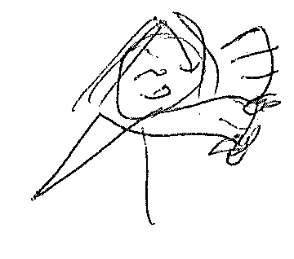
Do advnehoi nigohilv?
Ahltawosgoi.
Galtawosgoi.
a- 3rd Singular
g- 1st Singular
g- ~ a- a-Stem Pronoun Pattern
-ahltawosg- Imperfective Stem

Slide 12
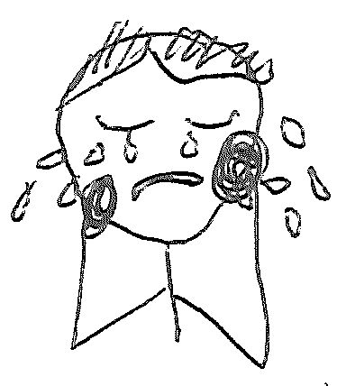
Do advnehoi nigohilv?
Atsohyihoi.
Gatsoyihoi.
a- 3rd Singular
g- 1st Singular
g- ~ a- a-Stem Pronoun Pattern
-atsohyih- Imperfective Stem

Slide 13
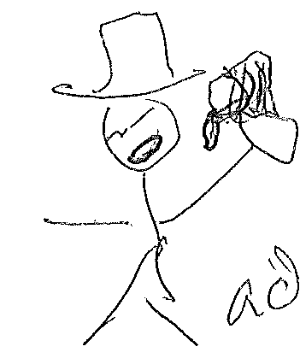
Do advnehoi nigohilv?
Aditasgoi.
Gaditasgoi.
a- 3rd Singular
g- 1st Singular
g- ~ a- a-Stem Pronoun Pattern
-aditasg- Imperfective Stem

Slide 14
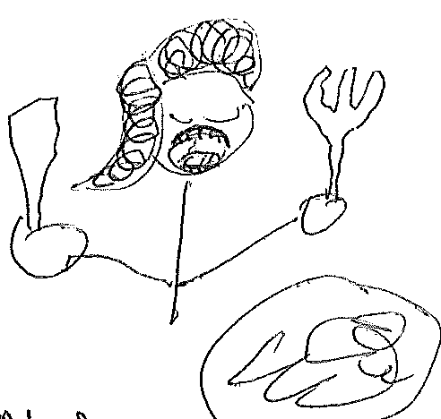
Do advnehoi nigohilv?
Alsdayvhvsgoi.
Galsdayvhvsgoi.
a- 3rd Singular
g- 1st Singular
g- ~ a- a-Stem Pronoun Pattern
-alsdayvhvsg- Imperfective Stem

Slide 15
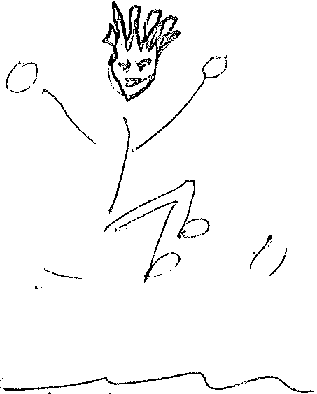
Do advnehoi nigohilv?
Dahltadegoi.
Degalitadegoi.
a- 3rd Singular
g- 1st Singular
g- ~ a- a-Stem Pronoun Pattern
de- -ahltadeg- Imperfective Stem

Slide 16
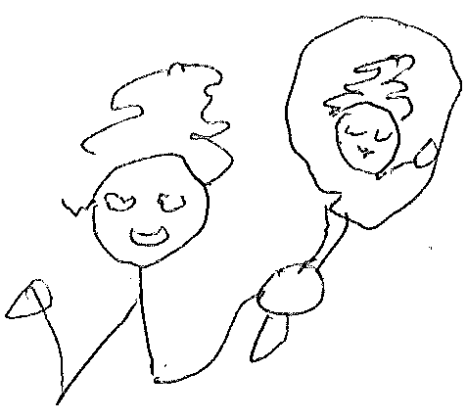
Do advnehoi nigohilv?
Adakesgoi.
Gadakesgoi.
a- 3rd Singular
g- 1st Singular
g- ~ a- a-Stem Pronoun Pattern
-adakesg- Imperfective Stem

Slide 17
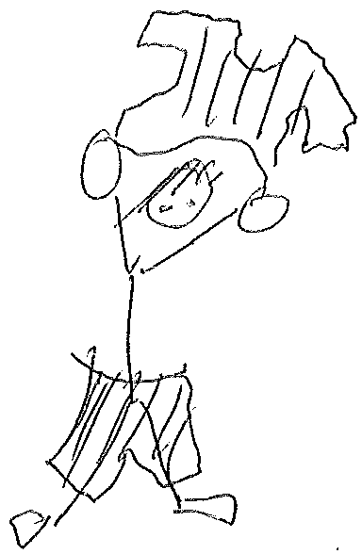
Do advnehoi nigohilv?
Ahnawosgoi.
Ganiwosgoi.
a- 3rd Singular
g- 1st Singular
g- ~ a- a-Stem Pronoun Pattern
-ahnawosg- Imperfective Stem

Slide 18
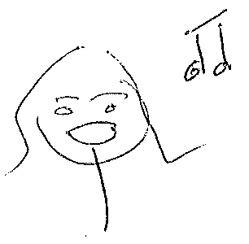
Do advnehoi nigohilv?
Dekanogisgoi.
Detsinogisgoi.
ga- 3rd Singular
tsi- 1st Singular
tsi- ~ ga- Consonant Stem Pronoun Pattern
de- -hnogisg- Imperfective Stem

Slide 19
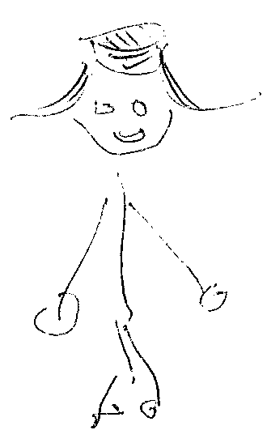
Do advnehoi nigohilv?
Gadogoi.
Tsidogoi.
ga- 3rd Singular
tsi- 1st Singular
tsi- ~ ga- Consonant Stem Pronoun Pattern
-dog- Imperfective Stem

Slide 20
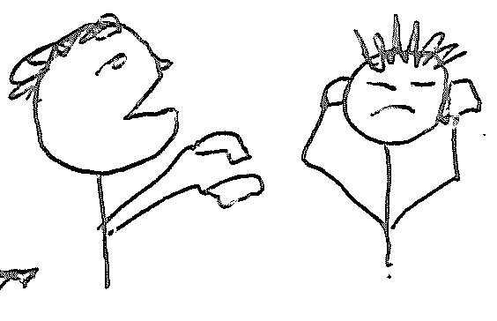
Do advnehoi nigohilv?
Gawonisgoi.
Tsiwonisgoi.
ga- 3rd Singular
tsi- 1st Singular
tsi- ~ ga- Consonant Stem Pronoun Pattern
-wonisg- Imperfective Stem

Slide 21
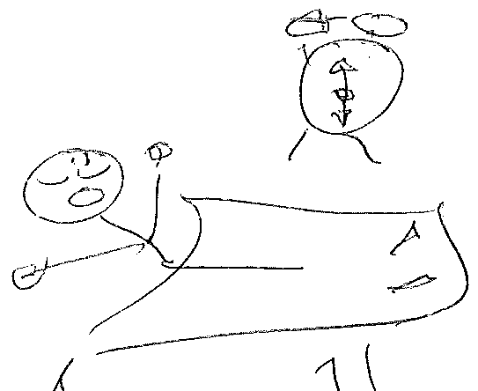
Do advnehoi nigohilv?
Ayegoi.
Tsiyegoi.
a- 3rd Singular
tsi- 1st Singular
tsi- ~ a- Consonant Stem Pronoun Pattern
-yeg- Imperfective Stem

Slide 22
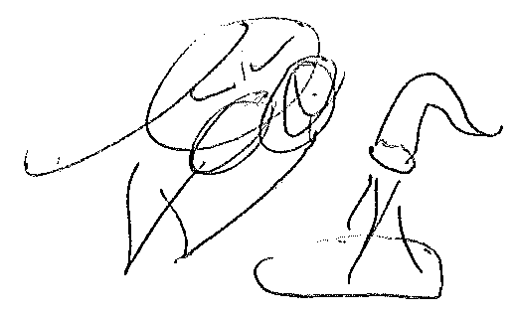
Do advnehoi nigohilv?
Agvsgwosgoi.
Tsigvsgwosgoi.
a- 3rd Singular
tsi- 1st Singular (DF Gagvsgwosgoi.)
?- ~ a- a-Stem Pronoun Pattern
-agvsgwosg- Imperfective Stem

Slide 23
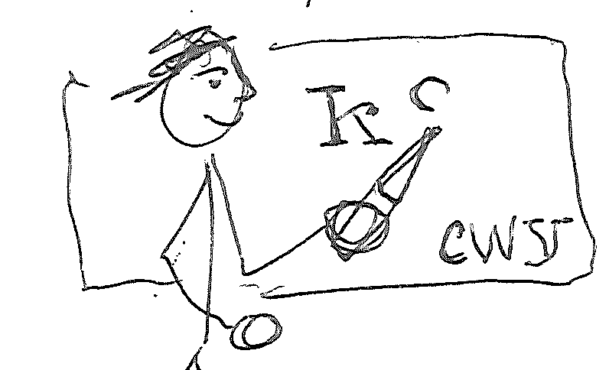
Do advnehoi nigohilv?
Gohwelisgoi.
Gowelisgoi.
g- 3rd Singular
g- 1st Singular
g- ~ g- Vowel Stem Pronoun Pattern
-ohwelisg- Imperfective Stem

Slide 24
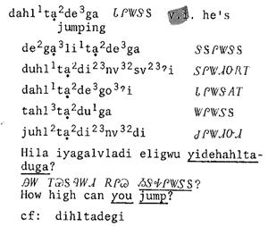
Jump
3rd Sg. Present
1st Sg. Present
3rd Sg. Perfective
3rd Sg. Imperfective
2nd Sg. Immediate
3rd Sg. Infinitive
Feeling, Durbin. 1975. Cherokee English Dictionary.

Slide 25
Activity Structure Dialogues
1. 3rd Person Singular Present
Do advneha? What is he doing?
Daltadega. He's jumping.

Slide 26
Activity Structure Dialogues
2. 2nd Person Singular Immediate Command
Hawa. Taltaduga, nihi utsawada!
Oh. You jump, you kangaroo!

Slide 27
Activity Structure Dialogues
3. 1st Person Singular Present
Hawa, degalitadega.
Okay, I'm jumping.

Slide 28
Activity Structure Dialogues
4. 2nd and 1st Person Singular Imperfective Habitual
Nigohilvitsu dehaltadegoi?
Do you always jump?
Vv, nigohilv degalitadegoi.
Yes I always jump.

Slide 29
Eat meal Verb Structure Dialogue
What is he doing?
He's eating a meal.
Oh. You eat meal, you hungry one!
Okay, I'm eating a meal.
Do you always eat a meal?
Yes, I always eat a meal.

