Slide 1
ᏣᎳᎩ ᎦᏬᏂᎯᏍᏗ 132
ᏦᎢᏁ ᎢᎦ, ᎠᏅᏱ 26, 2014

Slide 2
Types of Nouns
Simple Nouns
Simple Nouns do not change. They do not take plural marking. Plural marking is carried on the verb.
nuna svgta tsuhla gadu
potato apple fox bread
wesa inada yona nvda
cat snake bear sun/moon

Slide 3
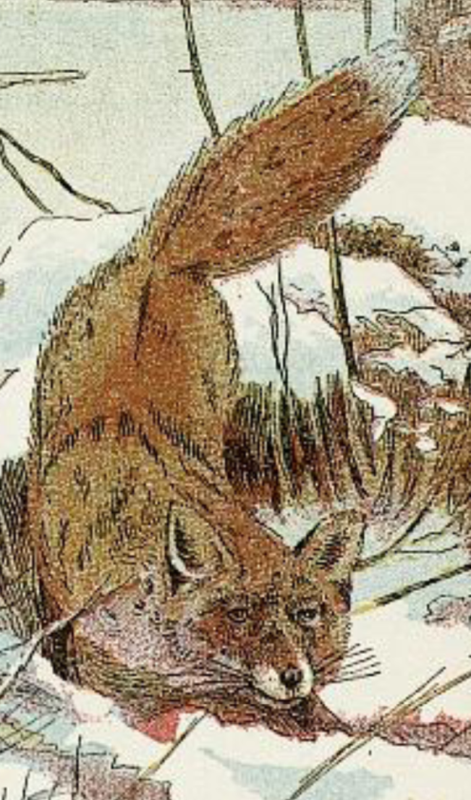
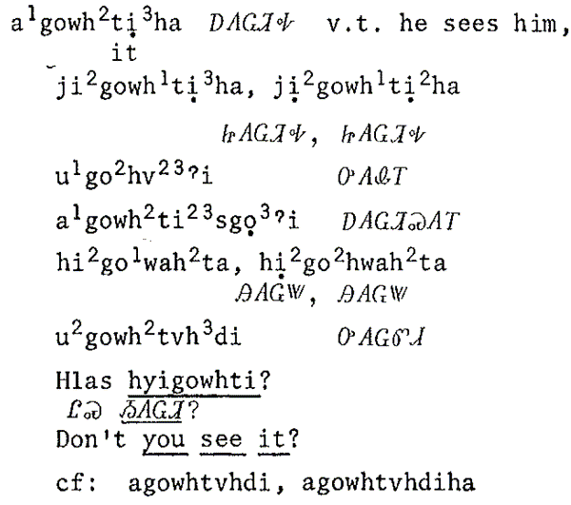
Verb Carries Plural
Tsuhlasg higowatiha?

Slide 4
Verb Carries Plural
Tsuhlasg dehigowatiha?

Slide 5
Verb Carries Plural
Simple nouns do not change. The verb indicates the plural of the noun.
Nunasg tsaduliha? Do you want a potato?
Nunasg detsaduliha? Do you want potatoes?
Hvga iga nuna detsaduliha?
How many potatoes do you want?

Slide 6
2. Possessed
Possessed Nouns show Person marking for the possessor. Possessed Nouns are marked for Plural. Clothes and Body.
Agi-/Agw- Set ‘shirt’
agwahnawo’i uhnawo’i
Tsi-/G- Set ‘ears’
ditsilena digalena

Slide 7
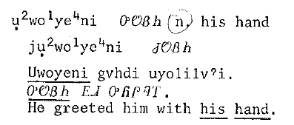
2. Possessed
Possessed Nouns show Person marking for the possessor. Possessed Nouns are marked for Plural.
agwoyeni my hand
digwoyeni my hands
agw- ~ uw- Vowel Stem Pronoun Pattern
with ts- Plural before u and o, di- Plural elsewhere.

Slide 8
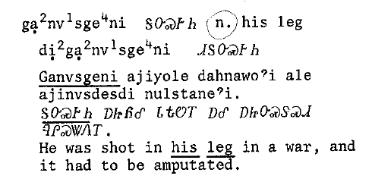
2. Possessed
Possessed Nouns show Person marking for the possessor. Possessed Nouns are marked for Plural.
tsinvsgeni my leg
ditsinvsgeni my legs
tsi- ~ ga- Consonant Stem Pronoun Pattern
with ts- Plural before o, di- Plural elsewhere.

Slide 9
3. Human Reference
Nouns that refer to humans often take Tsi-/G- Set Pronouns that reference the Person of the human.
tsisgaya asgaya man
tsigehya agehya woman
Otsitsutsa tsigesv …when we were boys…

Slide 10
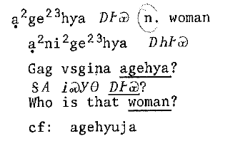
3. Human Reference
Nouns that refer to humans often take Tsi-/G- Set Pronouns that reference the Person of the human.
tsi-gehya
hi-gehya
agehya
ani-gehya
tsi- ~ a- Consonant Stem Pronoun Pattern

Slide 11
4. Relationship
4a. Reciprocal Relationship. Sisters are sisters to each other. Brothers are brothers to each other. Friends are friends to each other. Plural Intransitive Person pronouns.
dosdadanvtsi he and I are brothers
dosdadalv’i she and I are sisters
oginali’i he/she and I are friends

Slide 12
Vocabulary
Reciprocal Relationship Nouns
dosdadanvtsi we two are brothers
dosdadalv’i we two are sisters
Kag iyusdi disdadanvtsi? Who is your bro?
Disdadalv’itsu eha? Do you have a sister?

Slide 13
4. Relationship
4b. Non-Reciprocal Relationship. Mother-child, father-child, etc. are non-reciprocal relationships.
agi- Set Pronouns
agitsi she is mother to me, my mother
tsatsi she is mother to you, your mother
utsi she is mother to him/her

Slide 14
Vocabulary
Relationship Nouns
agitsi ᎠᎩᏥ my mother
agidoda ᎠᎩᏙᏓ my father
agido’i ᎠᎩᏙᎢ my o.s. sib
2nd Person and 3rd Person forms
tsatsi utsi
tsadoda udoda

Slide 15
4. Relationship
4b. Non-Reciprocal Relationship. Mother-child, father-child, etc. are non-reciprocal relationships.
tsi- Set Pronouns
tsitsi I am her mother
hitsi you are her mother

Slide 16
Family Dialogue
Han: Luga, kag iyusdi tsadoda?
Luga: Gesdi yitsigata.
Kag iyusdi agidoda, Ogwiwani?
Ogwiwani: Hiyatvdahvga Dahli Weda.
Luga: Dahli Weda, kag iyusdi agidoda?
Dahli Weda: Gvdoda, Luga.
Luga: Ha! Hadi! Gesdi sgidoda yigi!
Le'a: Iginidoda, Luga.
Luga: Do gi? Sgido'i-tsu?

