Slide 1
ᏣᎳᎩ ᎦᏬᏂᎯᏍᏗ 132
ᎤᎾᏙᏓᏉᏅᎢ, ᎧᏬᏂ 14, 2014

Slide 2
Course Overview
4/14 Review of Verb Stems – Closer look at the verbs of the assessment tool
4/16 Tom/Hartwell meet UNCCH
(WCU Easter Break)
4/21 Assessment Tool and integration of Future
4/23 UNCCH last day in class – Final Review
4/28 WCU Final Review
4/30 Final Exam Due

Slide 3
Adjectives in Context
A: Tsalvgwditsu agwatseli dagwalela?
B: Do ulsuhwida tsatseli dagwalela?
A: Dalonige agwatseli dagwalela.
-tsalvgwdi ‘like Present’ Agi-Verb, agi~u Pattern
-atseli ‘possess Adjective’ Agw-Adjective, agw~u Pattern

Slide 4
Adjectives - Receptive
Proctor provides color, Learner indicates understanding.
Do [iy]usdi gigage? (usdi ‘which’ Eastern)

Slide 5
Adjectives - Productive
Do ulsuhwida hia dagwalela?

Slide 6
Adjectives – Receptive/Productive
Do usdi utana dagwalela?
Do usdi usdi dagwalela?
Do usdi uwoduhi dagwalela?
Do usdi dagwalela tsaduliha?
Do usdi dagwalela tsalvgwdi?

Slide 7
Nihi nigada nogwu!

Slide 8
Cars/Shirts on Overhead Projector
Dagwalela – Simple Noun does not change
Ahnawo – Possessed Clothing has independent and possessed forms and takes di ~ ts Noun Plural
Ahnawo Dihnawo
Agwahnawo Digwahnawo
Tsahnawo Ditsahnawo
Uhnawo Tsuhnawo

Slide 9
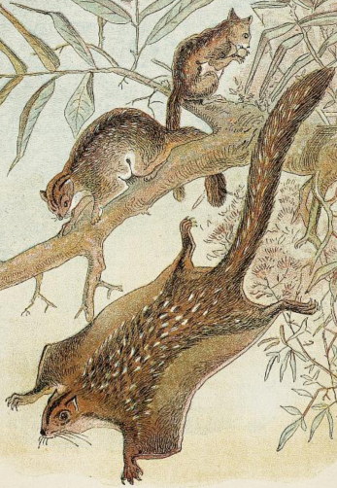
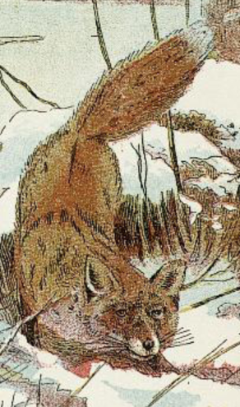
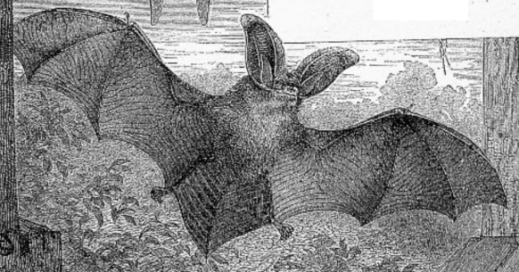
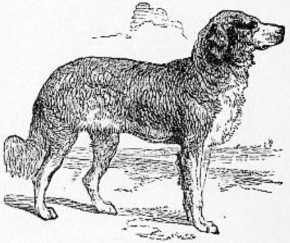
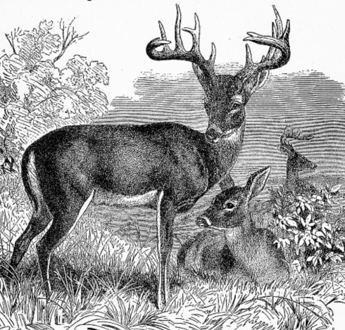
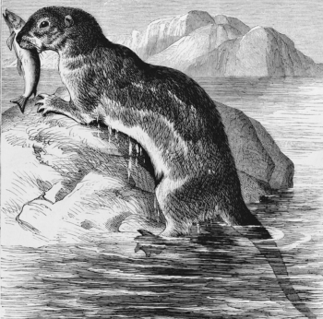
Noun Vocabulary - Receptive
nvhgi dininvsgeni ‘four leggeds’
Do usdi tsameha?

Slide 10
Noun Vocabulary - Productive
Do iyusdi hia?
Do iyusdi hia tsidatsilosdi?

Slide 11
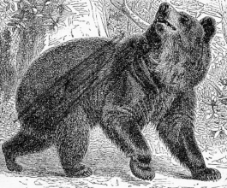
Extending with verbs
Command this bear to act!
Halsgi, yona!
Tihnogi, yona!
Halsdayvhvga, yona!
Other commands –
Immediate Command for common activities

Slide 12
Acts Review
Present
Immediate Command
Imperfective Habitual

Slide 13
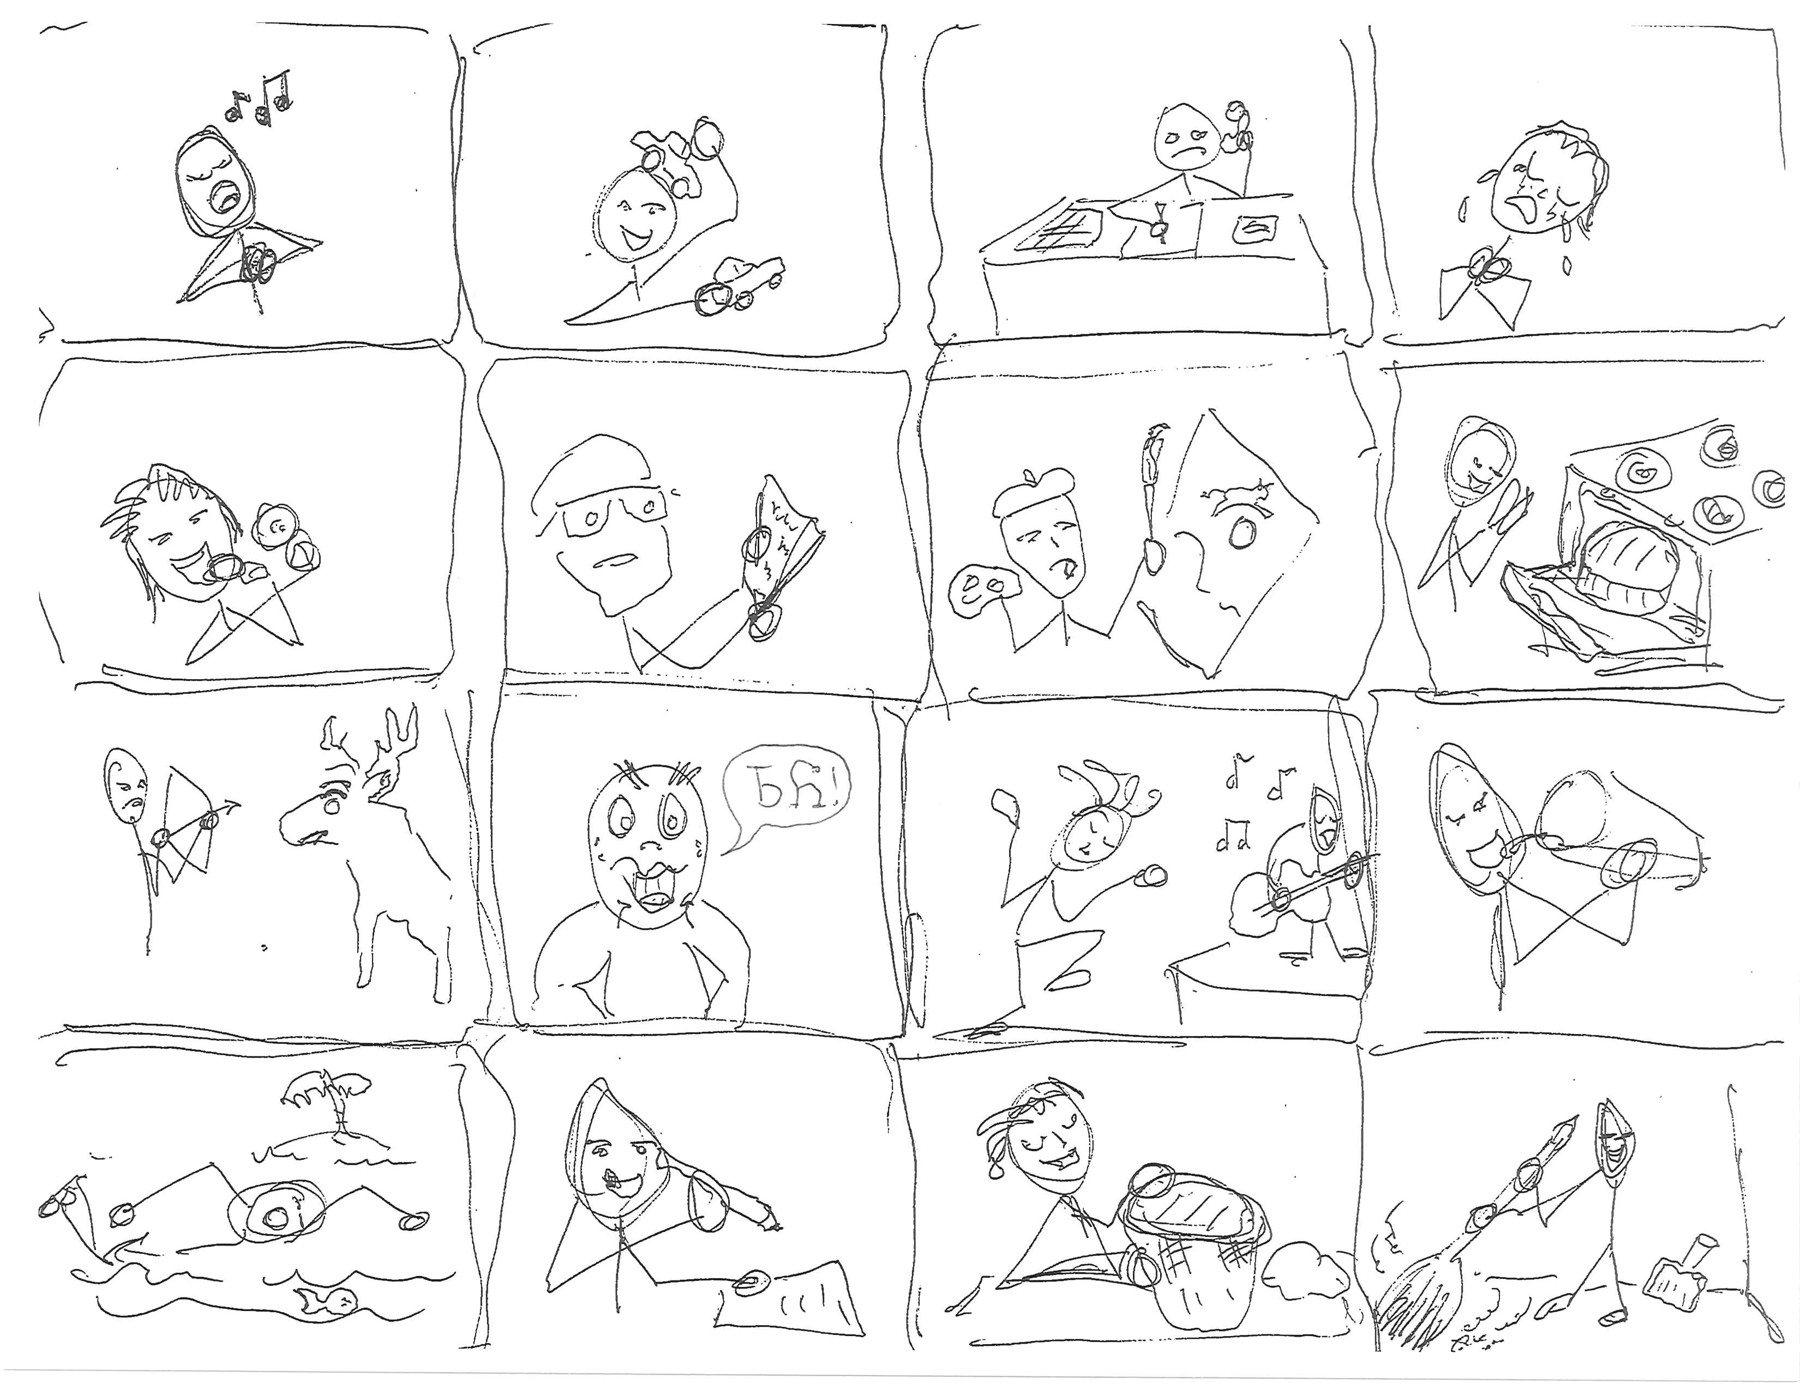

Slide 14
Command Plural
Command these deer to act.
Itsowelvga, ahwi!
Itsadawotsa, ahwi!
Other 2nd Person Plural
Immediate Commands -

Slide 15
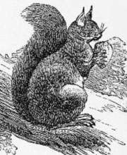
Present Activities
Describe what this squirrel is doing.
Saloli alsdayvhvsga.
Saloli gule agia.
Saloli uwohla.
Saloli daltadega.
Other activities -

Slide 16
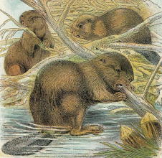
Present Activities
Describe what these beavers are doing.
Doya danihnogia.
Doya gansda danisdigia.
Doya anadawoa.
Other 3rd Plural Present
Activites-

Slide 17
Expanding to Other Persons
He/She and I – 1st Person Dual Exclusive
Do iyusdi tsuhla sdadvneha?
What are you and the fox doing?
Tsuhla dosdihnogia!
The fox and I are singing!
Stonehenge dosdedoha.
We are walking around Stonehenge.

Slide 18
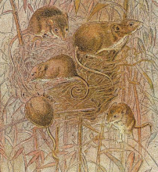
Expanding to Other Persons
They and I – 1st Person Plural Exclusive
(Excludes ‘you’ the 2nd Person to whom I am speaking.)
Do iyusdi tsisdetsi itsadvneha?
What are you and the mice doing?
Otsatsohyiha. We are crying.
[because - Dogiyosiha. We are hungry.]

Slide 19
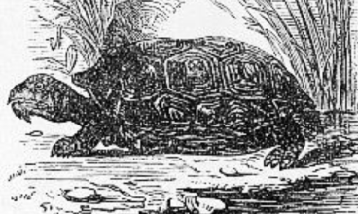
Nihi nigada nogwu!
Command to your classmates and this turtle.
You all … 2nd Person Plural
Its- one activity for all
Dits- multiple activity
events
Then describe Habitual Activity of turtle based on the command.

Slide 20
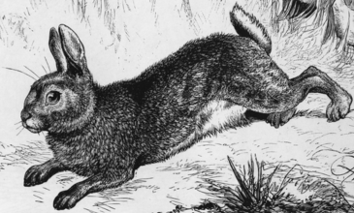
Nihi Nigada Nogwu!
Command one classmate and this rabbit.
You two … 2nd Person Dual
Sd- one event
Disd- multiple events
What do you and this rabbit always do? Habitual based on commands.

